Slide 1
1 Martin D-28 (自分で購入)

Slide 2
2 Martin HD-28VR

Slide 3
3 Morris W-40

Slide 4
4 Martin D-35

Slide 5
5 Martin D-45

Slide 6
6 Gibson DOVE

Slide 7
7 Martin D-28 (ヤフオク)

Slide 8
8 Martin OO-18V

Slide 9
9 Martin HD-28

Slide 10
10 Martin OOO-18

Slide 11
11 Martin O-18

Slide 12
12 Martin O-18 (pick)

Slide 13
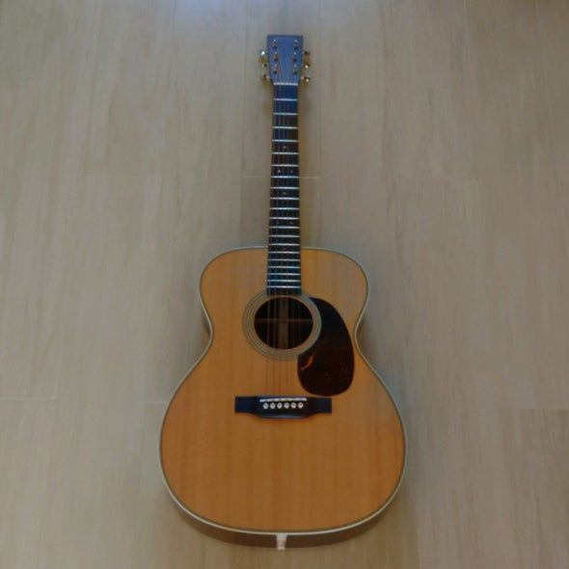
13 Martin OOO-28

Slide 14
14 Gibson Hummingbird

Slide 15
15 Gibson J-45

Slide 16
16 Martin D-18

Slide 17
17 K.Yairi DY-41

Slide 18
18 Guild F30W

Slide 19
19 Gallagher G-50

Slide 20
20 Guild D-240E

Slide 21
21 K.Yairi YW-500P

Slide 22
22 S.Yairi YD-220

Slide 23
23 Cat's Eyes CE-2000

Slide 24
24 Morris M-101Ⅲ

