Slide 1
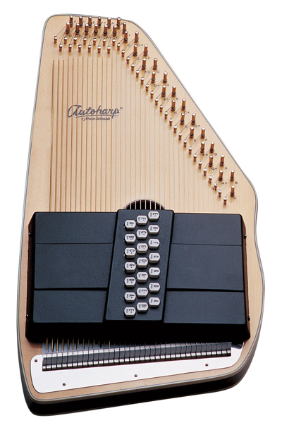
FOLK
OS10021
COLOR Natural
SKU OS10021-U
Great Overtones
The Centurion OS100 has the purest overtones of any Autoharp that we offer. It features a solid spruce top, mahogany back, and a laminated rock maple pin block to ensure it is always in tune.
SPECIFICATIONS
BODY & CONSTRUCTION
Top Wood
Solid Spruce
Back Wood
Mahogany
Type
Autoharps
OTHER
Color
Natural
Finish
Gloss
Additional Info
21 Chords / Laminated Rock Maple Pin Block

Slide 2
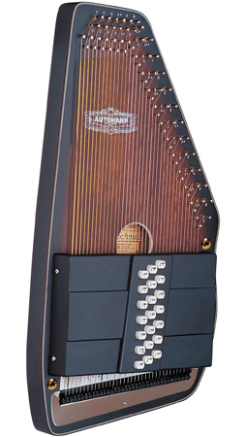
FOLK
OS11021AE
COLOR Natural
SKU OS11021AE-U
Bluegrass Magic with The Americana Autoharp
Play in all your favorite keys with our totally new chord bar arrangement. We’ve added Special Chords for bluegrass, folk, old-timey, and traditional music, including E major, F# minor and B minor. The OS11021AE is high-quality and versatile.
SPECIFICATIONS
BODY & CONSTRUCTION
Top Wood
Ovangkol
Back Wood
Solid Spruce
Type
Autoharps
ELECTRONICS
Pickups
Passive Electronic P/U
OTHER
Color
Natural
Finish
Satin
Additional Info
21 Chords
HARDWARE
Tuners

Slide 3
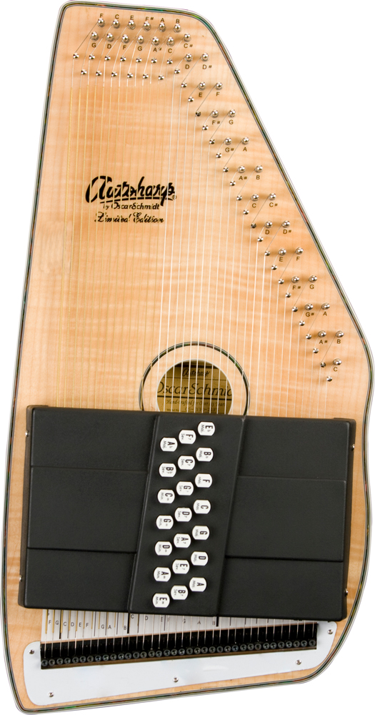
FOLK
OS11021FNE
COLOR Natural
SKU OS11021FNE-U
Our Finest
The Limited Autoharp
Spectacular in design and workmanship, the OS110 features our exclusive FT600 Fine Tuning System combined with a rock maple pin block to assure you will always be in tune. This model also includes a built-in passive pickup for plugged in performance.
SPECIFICATIONS
BODY & CONSTRUCTION
Top Wood
Flame Maple
Type
Autoharps
ELECTRONICS
Pickups
Passive Electronic Pickup
OTHER
Color
Natural
Finish
Gloss
Additional Info
21 Chords / Rock Maple Pin Block

Slide 4
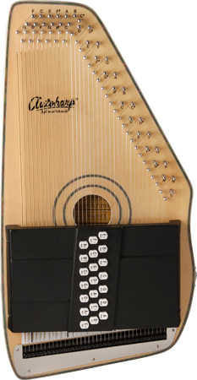
FOLK
OS120CNE
COLOR Natural
SKU OS120CNE-U
Our Finest
The Adirondack
Spectacular in design and workmanship, the OS120CN Adirondack features our exclusive FT600 Fine Tuning System combined with a rock maple pin block to assure it is always in tune. We have also added a passive electronic pickup to make it the perfect for on-stage playing.
SPECIFICATIONS
BODY & CONSTRUCTION
Top Wood
Solid Spruce
Back Wood
Birds Eye Maple
Type
Autoharps
ELECTRONICS
Pickups
Passive Electronic Pickup
OTHER
Color
Natural
Finish
Gloss
Additional Info
21 Chords / Rock Maple Pin Block

Slide 5
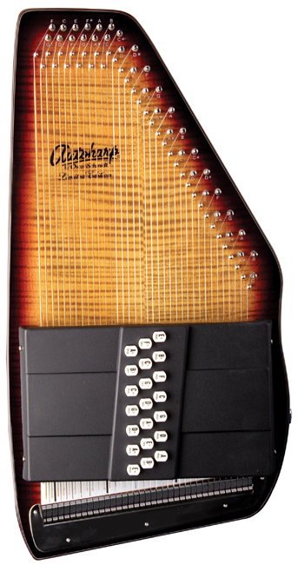
FOLK
OS150FCE
COLOR Natural
SKU OS150FCE-U
The OS150FCE has a rock maple pin block to assure it is always in tune. This model features flame maple top wood and a high-gloss finish.
SPECIFICATIONS
BODY & CONSTRUCTION
Top Wood
Flame Maple
Type
Autoharps
OTHER
Color
Natural
Finish
High Gloss
Additional Info
21 Chords

Slide 6
FOLK
OS11021FNE
COLOR Natural
SKU OS11021FNE-U
Our Finest
The Limited Autoharp
Spectacular in design and workmanship, the OS110 features our exclusive FT600 Fine Tuning System combined with a rock maple pin block to assure you will always be in tune. This model also includes a built-in passive pickup for plugged in performance.
SPECIFICATIONS
BODY & CONSTRUCTION
Top Wood
Flame Maple
Type
Autoharps
ELECTRONICS
Pickups
Passive Electronic Pickup
OTHER
Color
Natural
Finish
Gloss
Additional Info
21 Chords / Rock Maple Pin Block

Slide 7
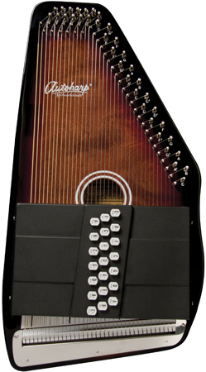
FOLK
OS21C
dark orange square
red square
dark blue square
COLOR Tobacco Sunburst
SKU OS21C-U
Our Most Popular Autoharp
The OS21C & OS21CQ are our most popular Autoharps. They feature a rock maple pin block, to assure you are always in tune, and maple back and top wood with a shiny gloss finish. This model comes in three vibrant colors so that you can choose which best matches your brand.
SPECIFICATIONS
BODY & CONSTRUCTION
Top Wood
Maple (Quilt Maple on OS21CQ Models)
Back Wood
Maple
Type
Autoharps
OTHER
Finish
Gloss
Additional Info
21 Chords / Rock Maple Pin Block

Slide 8
FOLK
OS21CE
COLOR Tobacco Sunburst
SKU OS21C-U
Our Most Popular Autoharp
The OS21C, OS21CE , and OS21CQ are our most popular Autoharps with a rock maple pin block to assure you are always in tune. These Autoharps have maple back and top wood and a shiny gloss finish.
This model also features a built-in passive electronic pickup for on-stage performing.
SPECIFICATIONS
BODY & CONSTRUCTION
Top Wood
Maple
Back Wood
Maple
Type
Autoharps
ELECTRONICS
Pickups
Passive Electronic Pickup
OTHER
Color
Tobacco Sunburst
Finish
Gloss
Additional Info
21 Chords / Rock Maple Pin Block

Slide 9
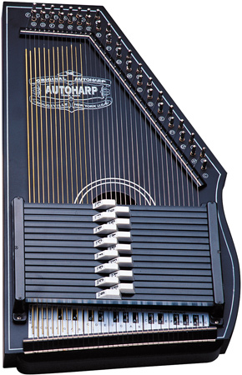
FOLK
OS73B
COLOR Black
SKU OS73B-U
Faithful Recreations
Our 1930s reissue models have been lovingly recreated based on the famous original design.
The OS73B features 15 chords, a solid spruce top, a mahogany back, and a classy black satin finish. This model has the classic look of the original Oscar Schmidt Autoharp with all the quality improvements of a completely new instrument.
SPECIFICATIONS
BODY & CONSTRUCTION
Top Wood
Spruce
Back Wood
Mahogany
Type
Autoharps
OTHER
Color
Black
Finish
Satin
Additional Info
15 Chords

Slide 10
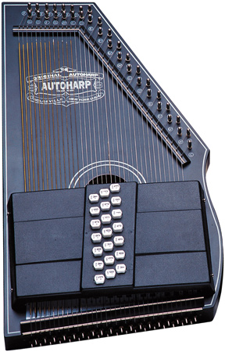
FOLK
OS73C
COLOR Black
SKU OS73C-U
Faithful Recreations
Our 1930s reissue models have been lovingly recreated based on the famous original design.
The OS73C features 21 chords, a solid spruce top, a mahogany back, and a classy black satin finish. This model has the classic look of the original Oscar Schmidt Autoharp with all the quality improvements of a completely new instrument.
SPECIFICATIONS
BODY & CONSTRUCTION
Top Wood
Spruce
Back Wood
Mahogany
Type
Autoharps
OTHER
Color
Black
Finish
Satin
Additional Info
21 Chords

Slide 11
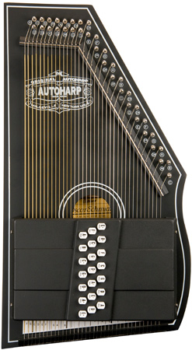
FOLK
OS73CE
COLOR Black
SKU OS73CE-U
Faithful Recreations
Our 1930s reissue models have been lovingly recreated based on the original design.
The OS73CE is a 21-chord model with a black satin finish and a passive electronic pickup for on-stage performing.
SPECIFICATIONS
BODY & CONSTRUCTION
Top Wood
Spruce
Back Wood
Mahogany
Type
Autoharps
ELECTRONICS
Pickups
Passive Electronic Pickup
OTHER
Color
Black
Finish
Satin
Additional Info
21 Chords

Slide 12
Oscar Schmidt Autoharp
OS10021
OS11021AE
OS11021FNE
OS120CNE
OS150FCE
OS15B
OS21C
OS21CE
OS73B
OS73C
OS73CE
スライド１１までが
Oscar schmidtのWebに
掲載されているモデル

Slide 13
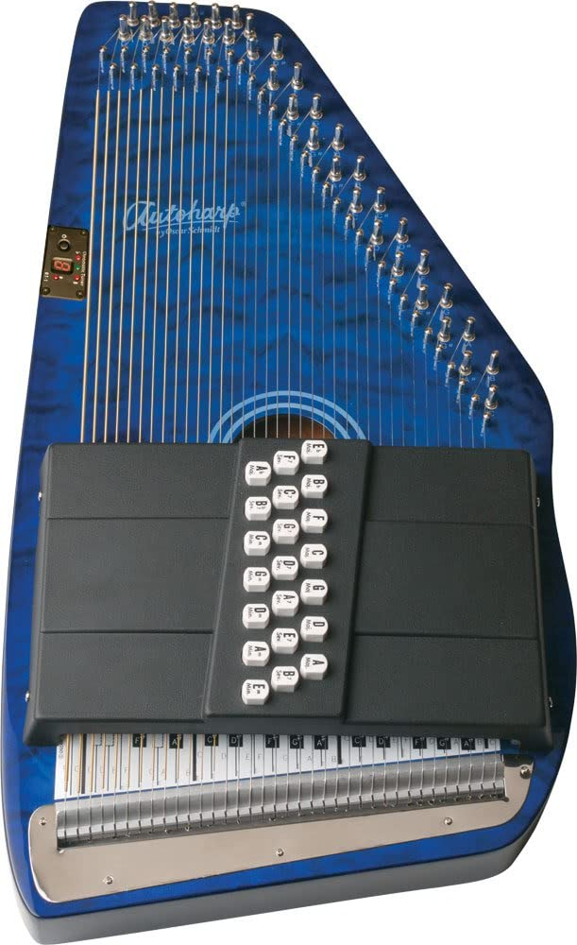
Oscar Schmidt OS21CQTBL Autoharp
Visit the Oscar Schmidt Store
4.4 out of 5 stars 38 ratings | 14 answered questions
Price: JPY 46,727 + JPY 12,545 Shipping & Import Fees Deposit to Japan Details
Available at a lower price from other sellers that may not offer free Prime shipping.
Brand Oscar Schmidt
Item Dimensions LxWxH 25 x 13 x 5 inches
Top Material Type Quilted Maple
Back Material Type Maple
String Material Type Stainless Steel
Finish Type Lacquered
Instrument Autoharp
Item Weight 12 Pounds
Operation Mode Electric
Number of Strings

Slide 14
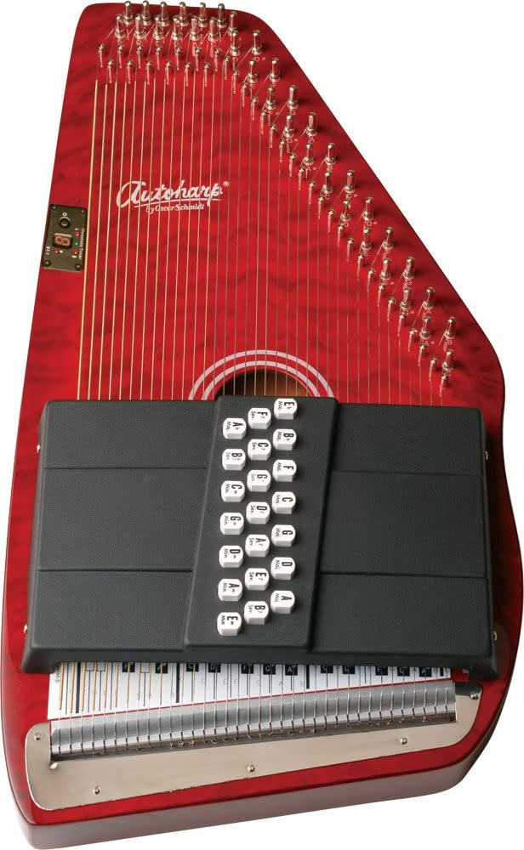
Oscar Schmidt OS21CQTR Autoharp
Visit the Oscar Schmidt Store
4.9 out of 5 stars 5 ratings
Price: JPY 46,627 + JPY 8,934 Shipping & Import Fees Deposit to Japan Details
Brand Oscar Schmidt
Item Dimensions LxWxH 25 x 13 x 5 inches
Top Material Type Maple
Back Material Type Maple
Item Weight 12 Pounds
Number of Strings 21
About this item
Handcrafted quality
Maple body with rock maple pin block
Quilted maple top
Gloss finish
21 Chords

Slide 15
https://www.autoharpstore.com/15chord.aspx
ort AutoHarps By:
Model # of Chords Wood Type Fine Tuning Electric Pickup Color # of Keys Price
OS11021FN 21 Flame Maple top-Solid Spruce back No No Natural 11 $379.95
OS11021AE 21 Top finish Ovangkol-Solid Spruce back Yes No Natural 11 $509.99
OS45C 21 Select Spruce top - Maple Back No No Natural 11 $369.99
OS73C 21 Solid Spruce Top - Mahogany Back No No Black Matte 11 $440.95
OS45CE 21 Select Spruce No Yes Natural 11 $369.99
OS120CNE 21 Solid Spruce top-Bird's eye Maple Back Yes Yes Natural 11 $459.90
OS11021FNE 21 Flame Maple top-Solid Spruce back Yes Yes Natural 11 $489.99
OS11021FHSE 21 Flame Maple top-Solid Spruce back No Yes Sunburst 11 $487.00
OS11021 Ozark 21 Ovankol top-Solid Spruce back No No Sunburst Satin 11 $399.95
OS120CN 21 Solid Spruce top-Bird's eye Maple Back Yes No Natural Gloss 11 $429.99
OS21CQTB 21 Maple Body No No Blue 11 $399.95
OS21C 21 Maple Body No No Sunburst 11 $375.95
OS21CQTR 21 Maple Body No No Red 11 $415.95
OS150FCE 21 Flame Maple top-Solid Spruce back No Yes Sunburst 11 $405.95
OS11021FHS 21 Flame Maple top-Solid Spruce back No No Sunburst 11 $409.99
OS10021 21 Solid Spruce Top - Mahogany Back No No Natural 11 $369.99
OS73B 15 Solid Spruce Top - Mahogany Back No No Black Matte 7 $425.95
OS15B 15 Maple Body No No Sunburst 7 $365.95
OS10015 15 Solid Spruce Top - Mahogany Back No No Natural 7 $279.99
15Ch ChromAharP 15 Maple Frame No No Sunburst 7 $265.64
21Ch ChromAharP 21 Maple Frame No No Sunburst 11 $341.95
21ChE ChromAharP 21 Maple Frame No Yes Sunburst 11 $340.00

Slide 16
https://www.autoharpstore.com/15chord.aspx
Model
OS11021AE
OS45C
OS73C
OS45CE
OS120CNE
OS11021FNE
OS11021FHSE
OS11021 Ozark
OS120CN
OS21CQTB
OS21C
OS21CQTR
OS150FCE
OS11021FHS
OS10021
OS73B
OS15B
OS10015

Slide 17
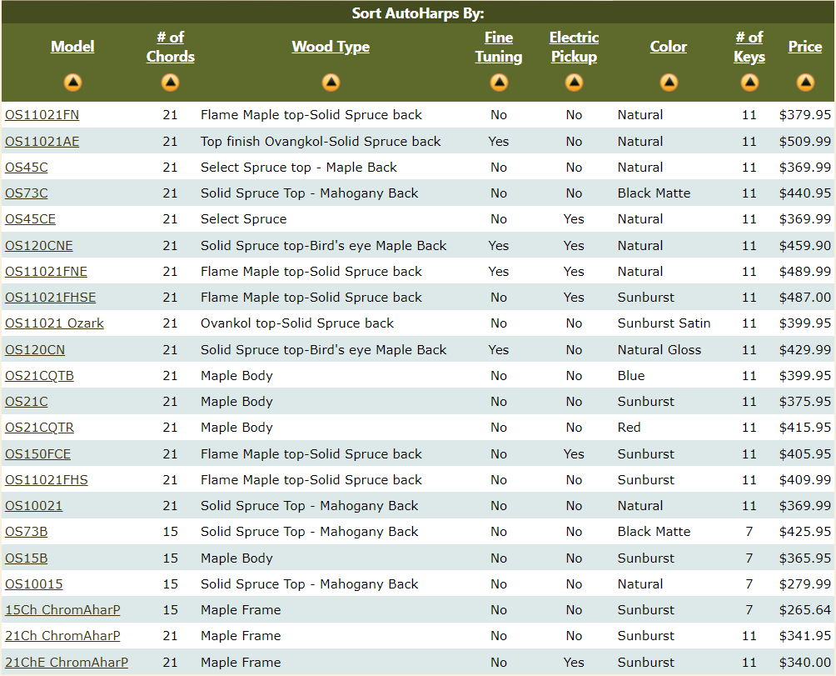
Oscar Schmidt Autoharp
OS10021
OS11021AE
OS11021FNE
OS120CNE
OS150FCE
OS15B
OS21C
OS21CE
OS73B
OS73C
OS73CE
----------------------------
OS21CQTBL amazon.com
OS21CQTR amazon.com
Model
OS11021AE
OS45C
OS73C
OS45CE
OS120CNE
OS11021FNE
OS11021FHSE
OS11021 Ozark
OS120CN
OS21CQTB
OS21C
OS21CQTR
OS150FCE
OS11021FHS
OS10021
OS73B
OS15B
OS10015

Slide 18
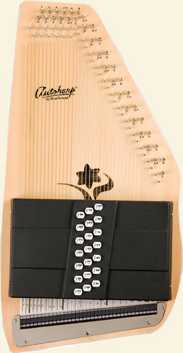
Oscar Schmidt OS45C AutoHarp - Appalachian –
Free Gig Bag and Chromatic Tuner
Normal Price $584.58 Sale Price $369.99
Product Specs
Model # OS45C - The Appalachian
Chords 21 Chord
Front Finish Spruce Top
Back Finish Maple Body
Additional Features Gloss Finish
Warranty 5 Years
Oscar Schmidt Autoharp
OS10021
OS11021AE
OS11021FNE
OS120CNE
OS150FCE
OS15B
OS21C
OS21CE
OS73B
OS73C
OS73CE
----------------------------
OS21CQTBL amazon.com
OS21CQTR amazon.com
Model
OS11021AE
OS45C
OS73C
OS45CE
OS120CNE
OS11021FNE
OS11021FHSE
OS11021 Ozark
OS120CN
OS21CQTB
OS21C
OS21CQTR
OS150FCE
OS11021FHS
OS10021
OS73B
OS15B
OS10015

Slide 19
Oscar Schmidt OS45CE Special Edition Electric AutoHarp - Free Gig Bag and Chromatic Tuner
Normal Price $584.58 Sale Price $369.99
Product Specs
Model # OS45CE - The Appalachian
Chords 21 Chord
Front Finish Spruce Top
Back Finish Maple Body
Additional Features Gloss Finish, Passive Pickup
Warranty 5 Years
Note: Autoharps no longer have built in tuners. (See promotions section for available tuners)
Model
OS11021AE
OS45C
OS73C
OS45CE
OS120CNE
OS11021FNE
OS11021FHSE
OS11021 Ozark
OS120CN
OS21CQTB
OS21C
OS21CQTR
OS150FCE
OS11021FHS
OS10021
OS73B
OS15B
OS10015

Slide 20
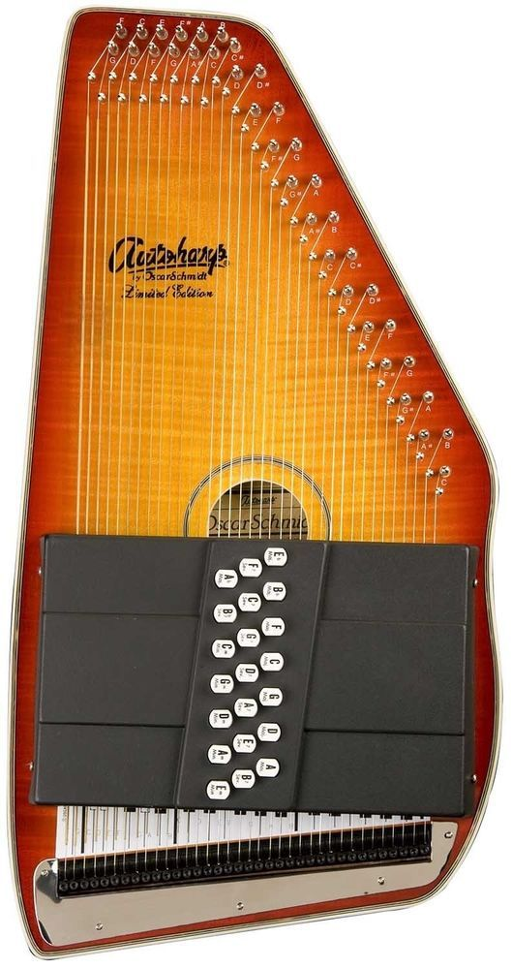
https://www.pinterest.ca/pin/438960294916029615/
Oscar Schmidt OS11021FHSE Flame Honeyburst Acoustic Electric 21 Chord Autoharp
Find many great new & used options and get the best deals for Oscar Schmidt OS11021FHSE Flame Honeyburst Finish Electric 21 Chord Autoharp at the best online prices at eBay! Free shipping for many products!
Model
OS11021AE
OS45C
OS73C
OS45CE
OS120CNE
OS11021FNE
OS11021FHSE
OS11021 Ozark
OS120CN
OS21CQTB
OS21C
OS21CQTR
OS150FCE
OS11021FHS
OS10021
OS73B
OS15B
OS10015

Slide 21
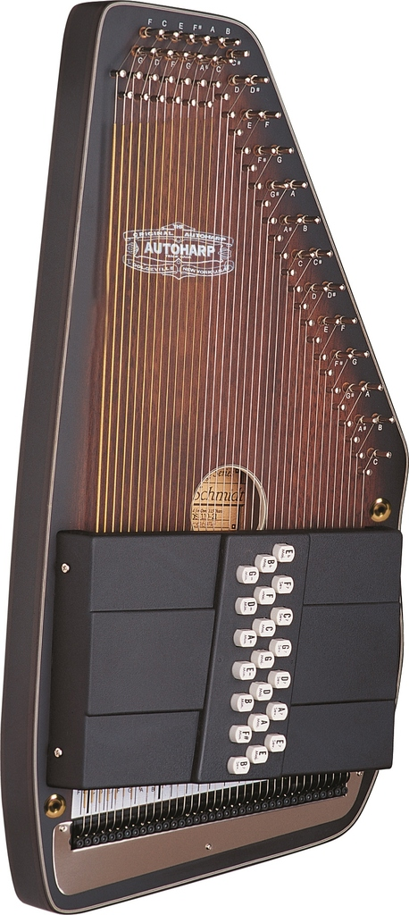
https://www.walmart.com/ip/Oscar-Schmidt-21-Chord-Autoharp-SOLID-Spruce-Back-OZARK-OS11021-by-Washburn/718580863
Oscar Schmidt 21 Chord Autoharp SOLID Spruce Back OZARK OS11021 by Washburn
Oscar SchmidtModel: OS11021
$399.00$399.00
Oscar Schmidt 21 Chord Autoharp
OS11021 - by Washburn
"OZARK"
Solid Spruce Back with a Satin Finish
Features:
MODEL: OS11021
- Handcrafted quality
- Ovankol top
- Solid spruce back
- Satin finish
21 Chords
Specifications
Features
built in ft600 tuning system, ovankol top, solid spruce back, satin finish
Model
OS11021
Brand
Oscar Schmidt
Manufacturer
Oscar Schmidt
Manufacturer Part Number
OS11021
Assembled Product Dimensions (L x W x H)
41.00 x 16.00 x 5.00 Inches
Model
OS11021AE
OS45C
OS73C
OS45CE
OS120CNE
OS11021FNE
OS11021FHSE
OS11021 Ozark
OS120CN
OS21CQTB
OS21C
OS21CQTR
OS150FCE
OS11021FHS
OS10021
OS73B
OS15B
OS10015

Slide 22
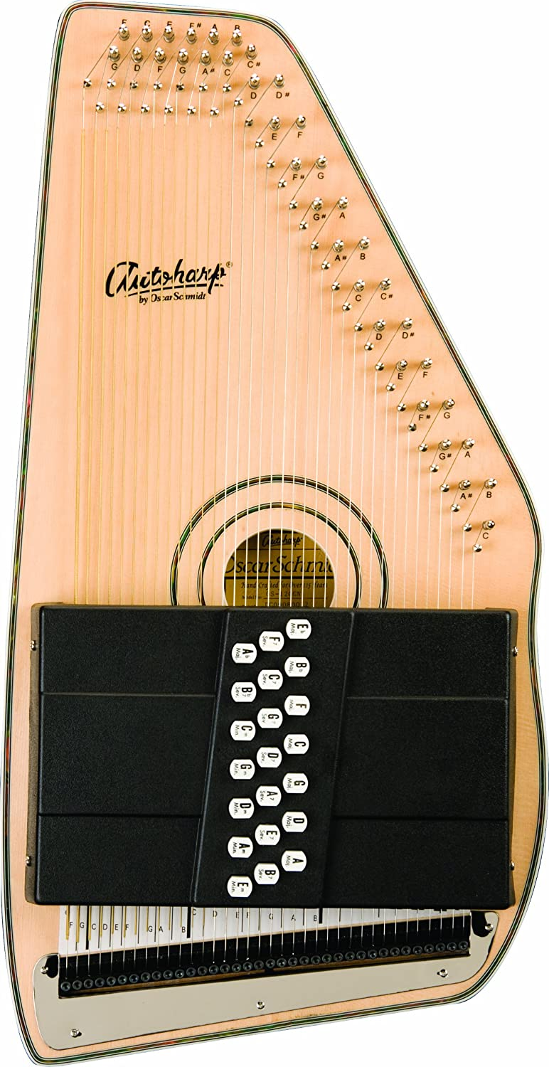
https://www.amazon.co.jp/Oscar-Schmidt-OS120CN-%E7%8B%AC%E8%87%AA%E3%81%AEFT600%E3%83%95%E3%82%A1%E3%82%A4%E3%83%B3%E3%83%81%E3%83%A5%E3%83%BC%E3%83%8B%E3%83%B3%E3%82%B0%E3%82%B7%E3%82%B9%E3%83%86%E3%83%A0%E3%82%92%E5%82%99%E3%81%88%E3%81%A6%E3%81%84%E3%82%8B%E2%98%85OS120CN%E3%82%AA%E3%83%BC%E3%83%88%E3%83%8F%E3%83%BC%E3%83%97-Oscar-Schmidt%E7%A4%BE%E3%80%90%E4%B8%A6%E8%A1%8C%E8%BC%B8%E5%85%A5%E3%80%91/dp/B001L8PJUQ
Model
OS11021AE
OS45C
OS73C
OS45CE
OS120CNE
OS11021FNE
OS11021FHSE
OS11021 Ozark
OS120CN
OS21CQTB
OS21C
OS21CQTR
OS150FCE
OS11021FHS
OS10021
OS73B
OS15B
OS10015
Oscar Schmidt 独自のFT600ファインチューニングシステムを備えているOS120CNオートハープ Oscar Schmidt社【並行輸入】
Brand: Oscar Schmidt
3.0 out of 5 stars 2 ratings
Click here for details of availability.
Weight: 6.8kg, Size: 104 x 41 x/13 cm
Oscar Schmidt OS120CN 21 Adirondak Autoharp Features:
21 Chords
Handcrafted quality
Solid Spruce Top
Bird's eye maple back
Built in FT600 Fine tuning system
Laminated rock maple pin block
Satin finish
Abalone rosette
Natural high gloss finish
5 Year Warranty
https://www.instrumentalley.com/Oscar-Schmidt-OS120CN-Autoharp-p/os120cn.htm

Slide 23
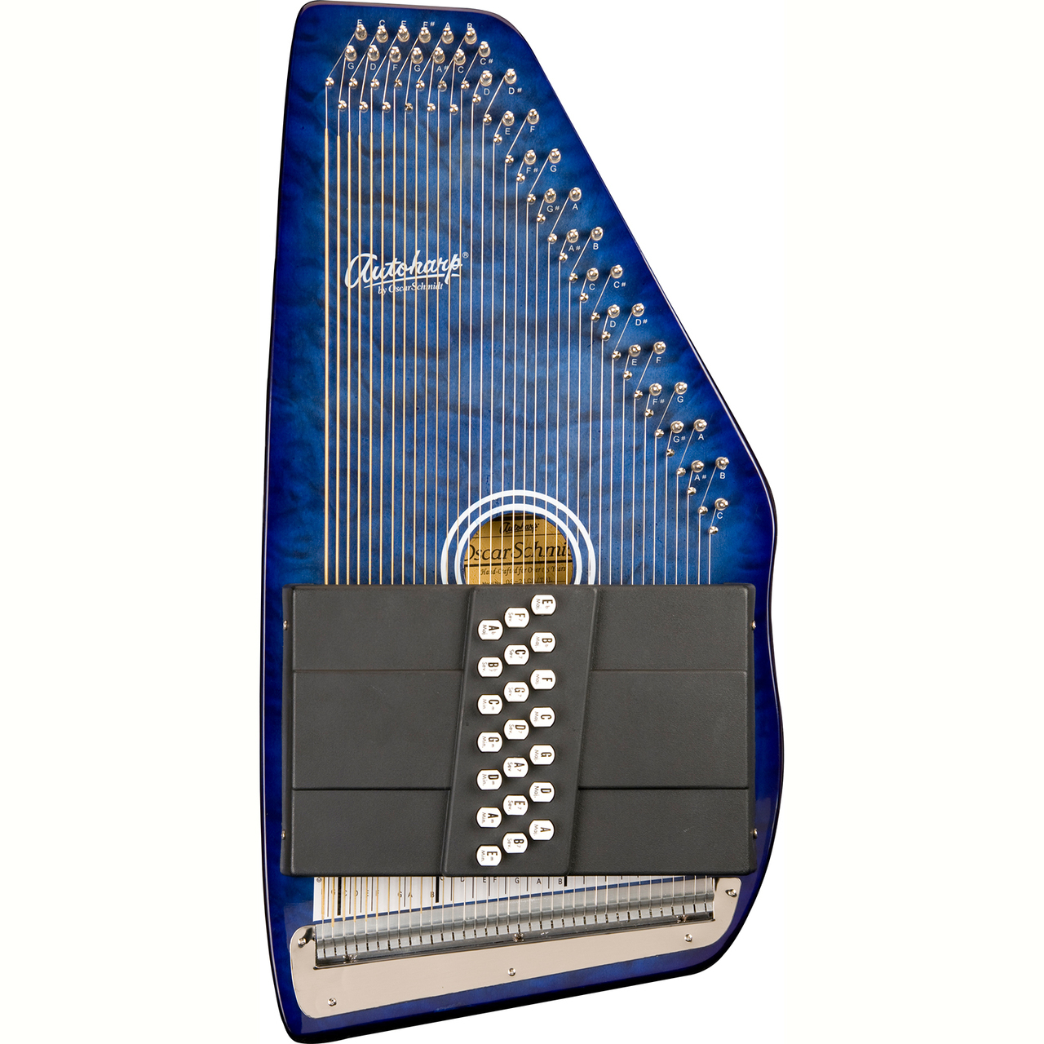
http://www.zozomusic.com/oscar-schmidt-os21cqtbl-classic-21-chord-autoharp-quilted-transparent-blue/
Oscar Schmidt OS21CQTBL Classic 21-Chord Autoharp, Quilted Transparent Blue
Oscar Schmidt
(No reviews yet) Write a Review
MSRP: $559.90
$429.99
(You save $129.91 )
SKU: OS21CQTBL
UPC: 801128500843
Shipping: Free Shipping
Brand: Oscar Schmidt
UPC: 801128500843
MPN: OS21CQTBL
Model
OS11021AE
OS45C
OS73C
OS45CE
OS120CNE
OS11021FNE
OS11021FHSE
OS11021 Ozark
OS120CN
OS21CQTB
OS21C
OS21CQTR
OS150FCE
OS11021FHS
OS10021
OS73B
OS15B
OS10015

Slide 24
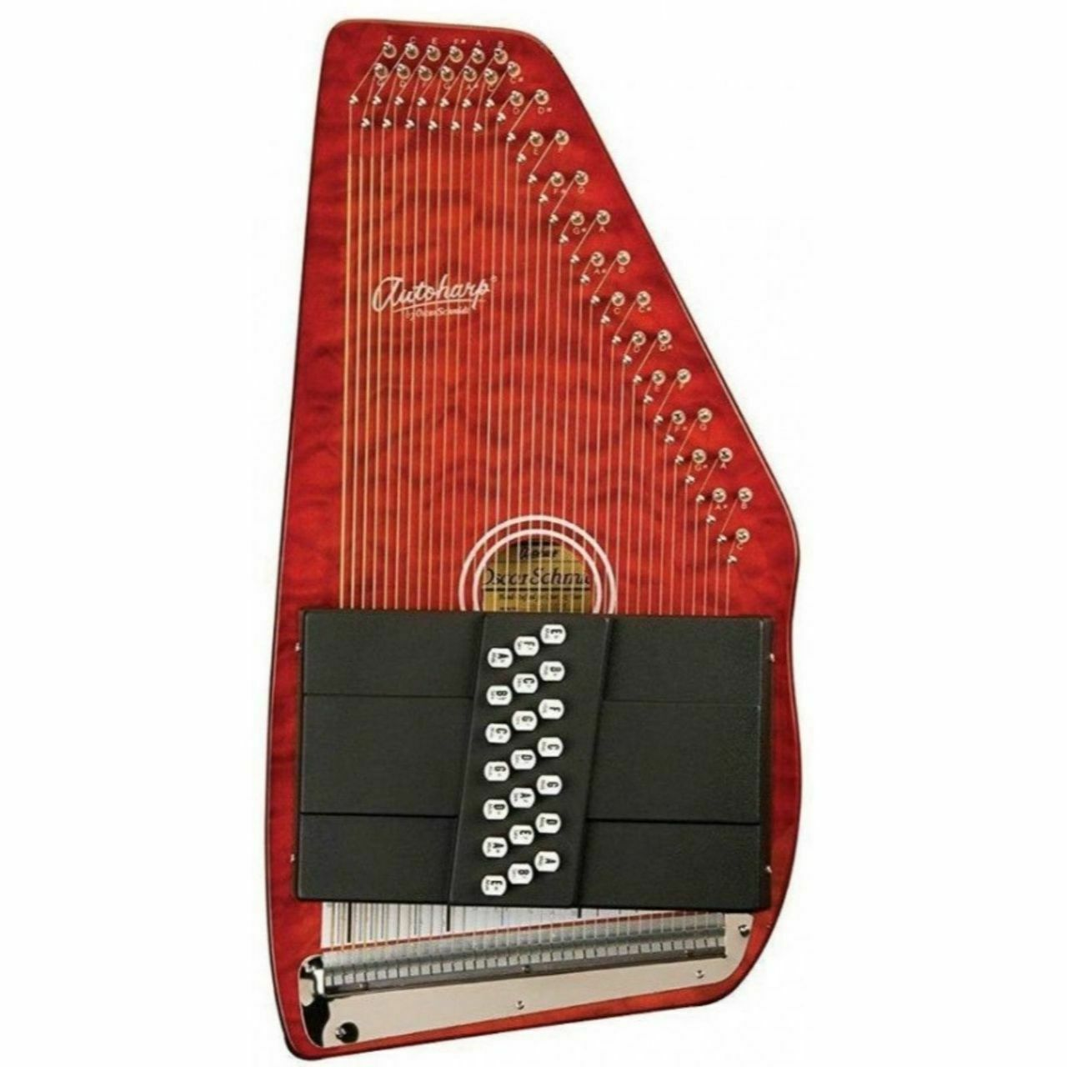
https://www.ebay.com/itm/Oscar-Schmidt-OS21CQTR-Classic-21-Chord-Autoharp-Quilted-Transparent-Red/183967553397
Oscar Schmidt OS21CQTR Classic 21-Chord Autoharp, Quilted Transparent Red
Condition:New
Quantity:1
6 available / 1 sold
Price:US $429.99
Approximately JPY 47,518
Model
OS11021AE
OS45C
OS73C
OS45CE
OS120CNE
OS11021FNE
OS11021FHSE
OS11021 Ozark
OS120CN
OS21CQTB
OS21C
OS21CQTR
OS150FCE
OS11021FHS
OS10021
OS73B
OS15B
OS10015

Slide 25
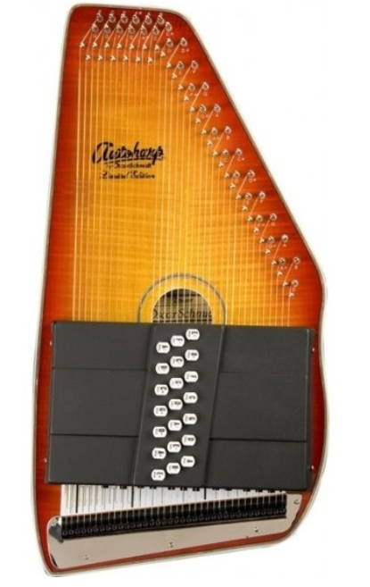
https://www.butlermusic.com/384-oscar-schmidt-os11021fhs-flame-honeyburst-acoustic-21-chord-autoharp
OSCAR SCHMIDT OS11021FHS FLAME HONEYBURST FINISH ACOUSTIC 21 CHORD AUTOHARP
MSRP: $749.90
$429.00
Save : $320.9
DESCRIPTION
The OS11021FHS features flame maple on the front and on the back of the autoharp is solid spruce. The natural wood tones are accentuated by the honey sunburst design. The glossy finish of this instrument will help protect this instrument for years to come. One downside of glossy finish is that it will slightly dampen the acoustic sound of the instrument as the finish is thicker than satin finishes. Oscar Schmidt constructed this limited edition autoharps the same way they have been building them for years. Each autoharp features a frame made of rock maple and a 10-ply rock maple pin block. The 10-ply rock maple pin block helps prevent the tuning pegs from moving once you have tuned your autoharp. The OS11021FHS feature sound cavities that are framed by maple and provide ample sound to play these autoharps acoustically.
Features
Unique Design: The OS11021FHS features flame maple on the front with natural wood tones that are accentuated by the honey sunburst design.
Gloss Finish: The gloss finish provides an added layer of protection to the autoharp, however, it does affect the tone slightly, giving it a lower sound.
Honey Sunburst: T
Incredible Strength: The pin blocks in many of the finest autoharps consist of hard rock maple for extra strength. The pin blocks are laminated, 10-ply rock maple pin blocks, meaning they are specially coated for extra strength. The purpose of the pin block is to firmly hold the tuning pins in place where the strings are attached. The added strength of the laminated rock maple ensures that everything will stay in the right place. The Autoharp, like the piano, is a tempered scale, so the same string is used in several chords; even when perfectly in-tune in one chord, it may sound slightly sharp or flat in another. Over time as the strings loosen, you can use fine tuning to tighten them, so the strings can reach their limits. The first twang of a string is higher and the tone settles in after a second.
Model #: OS-110-21FHS
Chords: 21
Front Finish: Honey Sunburst / Flame Maple
Honey Sunburst / Solid Spruce
Additional Features: Gloss Finish, Acoustic
NUMBERS
Model
OS11021AE
OS45C
OS73C
OS45CE
OS120CNE
OS11021FNE
OS11021FHSE
OS11021 Ozark
OS120CN
OS21CQTB
OS21C
OS21CQTR
OS150FCE
OS11021FHS
OS10021
OS73B
OS15B
OS10015

Slide 26
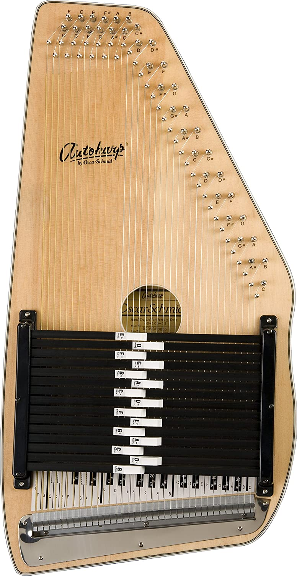
https://www.amazon.co.jp/Oscar-Schmidt-OS10015-OS10015-%E3%82%AA%E3%83%BC%E3%83%88%E3%83%8F%E3%83%BC%E3%83%97-Schmidt%E7%A4%BE%E3%80%90%E4%B8%A6%E8%A1%8C%E8%BC%B8%E5%85%A5%E3%80%91/dp/B000T02ZXG
OS10015 Auto Harp (15 Chord) Oscar Schmidt, Inc [parallel import goods]
Brand: Oscar Schmidt
5.0 out of 5 stars 2 ratings
Currently unavailable. Click here for details of availability.
We don't know when or if this item will be back in stock.
Brand Oscar Schmidt
Item Dimensions LxWxH 63.5 x 33 x 12.7 cm
Top Material Type メイプル, スプルース
Item Weight 10 Pounds
Number of Strings 21
About this item
Weight: 4.5kg, Size: 64 × 33 × 12.7 cm
Features: supuru-sutoppu, stacked rock meipurupinburokku
Model
OS11021AE
OS45C
OS73C
OS45CE
OS120CNE
OS11021FNE
OS11021FHSE
OS11021 Ozark
OS120CN
OS21CQTB
OS21C
OS21CQTR
OS150FCE
OS11021FHS
OS10021
OS73B
OS15B
OS10015

